Slide 1
Quality Assessment and Communicating Student Learning
Part 6:Student support
Notes:
Welcome to part ___ of the Quality Assessment and communicating student learning series.
You have watched a series of videos that has been designed to support teachers with quality assessment and communicating student learning with families and caregivers. This video narrows the focus to how to communicate student learning for student with diverse abilities and disabilities. Throughout the videos you will be given information and time to pause, reflect and discuss in table talk conversations. Each module also comes with resources that will support the learning. We acknowledge that the way that teachers assess and communicate student learning is unique to each of their practices, what we will be sharing in these modules are best practices based on research as well as ministry and district requirements.

Slide 2
Included in Part 6
Inclusion – Assessment and reporting for all students
New Reporting Order
ELL
Student with IEPs (all, few, some)

Slide 3
Learning ultimately supports the well-being of the self, the family, the community, the land, the spirits, and the ancestors. -FPPL
Each learner’s uniqueness is valued and appreciated. Each learner is perceived as having specific gifts that can be nurtured and supported to flourish.
Notes:
As mentioned in previous modules, our inclusive education system, redesigned curriculum and connected reporting policy prioritizes the participation, growth and development of all students.
In the context of an inclusive education system rooted in the First Peoples' Principles of Learning, we acknowledge that learning serves as a foundation for the well-being of the self, the family, the community, the land, the spirits, and the ancestors. These principles emphasize the significance of valuing and appreciating each learner's uniqueness, recognizing that they possess specific gifts that can be nurtured and supported to flourish. By embracing this perspective, our inclusive education system not only ensures equal access to education but also cultivates an environment where every student feels valued, respected, and empowered to thrive on their individual learning journey.

Slide 4
Assessment and Reporting for All
Inclusive education system in which all students, regardless of their identities, background, needs, abilities or circumstances, are fully participating members of a community of learners.
Students are entitled to equitable access to learning, resources, and the pursuit of excellence in all aspects of their educational programs.
Assessment and reporting practices must be inclusive of all students and reflect the histories, lived experiences, perspectives/worldviews, and cultures, and strengths.
Inclusive assessment practices allow students multiple opportunities to practice and demonstrate knowledge and competencies, which are assessed through observations, conversations, and multi-modal demonstrations of learning (Triangulating Evidence of Learning)
Notes:
To uphold these principles, our assessment and reporting practices need to be designed to be inclusive and accommodate the diverse needs and abilities of our students. With this we also recognize the importance of reflecting on the histories, lived experiences, perspectives/worldviews, cultures, and strengths of our learners in the assessment process. Our aim is to create an assessment framework that truly values the unique identities and capabilities of each individual, and to offer a variety of supports and access points, ensuring that every student has the opportunity to showcase their knowledge and competencies.
In addition, Inclusive assessment practices go beyond traditional methods and provide multiple opportunities for students to practice and demonstrate their knowledge and competencies. We understand that students have different learning styles and strengths, and therefore, we employ a variety of assessment techniques. This includes observations, conversations, and the use of multi-modal demonstrations of learning, allowing students to showcase their understanding and skills through different means.
By employing a triangulation of evidence of learning, we ensure that our assessment practices consider the whole student, taking into account their diverse abilities, experiences, and forms of expression. We aim to create a comprehensive assessment framework that captures the full range of student capabilities and provides a holistic understanding of their progress and achievements.
Our reporting system reflects these inclusive assessment practices, offering a comprehensive and meaningful portrayal of each student's growth and development. It provides a platform to communicate student progress, strengths, and areas for improvement to students, parents, and the wider educational community. We believe that inclusive reporting not only promotes transparency and accountability but also celebrates the unique accomplishments and contributions of every learner.

Slide 5
Multiple Pathways
Importance of Multiple Pathways:
Personalized approach to learning, access to curriculum and skill development, support individual needs and diverse abilities
Transparency in Assessments:
Defined proficiency scales and success criteria, Providing more access points for learners, Adapting scales to cater to diverse needs and abilities
Targeted Supports and Goals:
Varying levels of support needed, alternative methods for demonstrating learning (triangulating evidence of learning), individualized and replacement goals for additional assistance
Collaboration between Teachers:
Classroom and support teachers working together, understanding and meeting students' different needs, guidance for personalized learning paths
Student-Centered Approach:
Involving students and caregivers in the process, meeting students where they are, empowering students to demonstrate learning in their unique way
Notes:
This personalized approach to learning highlights the importance of creating multiple pathways for students to access the curriculum, and develop their skills, competencies, knowledge base and understandings.
While some students may readily access the curriculum goals, others may require varying levels of support or alternative methods to demonstrate their learning. This underscores the importance of offering targeted supports, individualized goals, and replacement goals for those who require additional assistance.
The more transparent we make our assessments, for example defined proficiency scales with co-constructing success criteria, the more access points we may provide our learners. For some, the scales may need to go further back in grade levels to find access points for our learners. The competency based or standards based design of our curriculum allows for the progression of learning to be defined for us and for our students. We may just need to go further back or further forward to find an access point for all learners as discussed in modules 5 and 8. However, some of our students may need entirely different goals, unique to their development.
Collaboration between classroom teachers and support teachers is very important in creating multiple pathways for students. By working together with students and/or caregivers, they can understand and meet their different needs at their own level of learning and for them to demonstrate that learning in the best way that they can. This teamwork ensures that students get the right support and guidance to follow their personalized learning paths.

Slide 6
Reporting for English Language Learners (ELL)
Reporting Requirements for ELL Students:
Same as other students following learning standards
Proficiency Scale and Letter Grades:
Appropriate if student can meet learning standards of the course
Students Not Meeting Learning Standards Due to Language Proficiency Level:
Not appropriate to use proficiency scale or letter grades
Description of student's abilities, what they can do
Areas needing improvement
Recommendations for support and further learning
More information to come for this scenario
Notes:
The reporting requirement for ELL students who are following the learning standards for a course are the same as for other students. In alignment with the English Language Learning Policy Guide (2018), provincial proficiency scale indicator or letter grades and percentages are appropriate for ELL where with supports, they are capable of meeting the learning standards for a particular area of learning. In other words, if they are able to demonstrate the learning standards of the course, than you will report with a proficiency indicator, or letter grade and percentage.
If the students are not yet able to meet the learning standards in some areas of learning due to their level of language proficiency, even with supports, then it would not be appropriate to use proficiency indicator or letter grades and percentage. In this case, reporting must contain information describing what the student CAN DO, areas that require further attention, and ways to support learning.
Along with the proficiency scale or percentages and letter grades it is particularly important to provide descriptive feedback. The progress report must contain information on what the student can do, areas that require further attention or development, and ways of supporting learning.
More information will be shared in relation to this scenario once its been made available.

Slide 7
Reporting on Language Acquisition within the Descriptive Comment Framework
Engagement
Language Acquisition
(Student) enthusiasm and willingness to take on new challenges in the language-learning process demonstrates (his/her/their) dedication to improving (his/her/their) English skills.
(Student) receives differentiated instruction within the classroom from an ELL specialist in the area of English Language and Literacy Development and is making _____________progress in (choose one or more of the domains- oral language, reading and/or writing). (Student) is (include student strength(s), and what they can do, and is working on (include next steps for improvement.
Next steps
Strengths
Notes:
While student progress will be communicated using the proficiency scales and or percentages and letter grades, the ministry has additional requirements for this group of learners. Classroom teachers must also report on the progress in the development of English language proficiency to parents in each of the school’s regular reporting periods.
Classroom teachers and ELL specialists/case mangers must collaborate to ensure that reporting is accurate and authentic either by providing information on a student's progress, or by reviewing and approving the information.
This slide shows an example of a strength based descriptive feedback comment that also incorporates reporting on language development.
Please pause the slide here for a couple of minutes.

Slide 8
PAUSE
With the understanding that limited language does not necessarily mean limited knowledge, how can we authentically assess ELL students?
What alternative ways can we capture evidence of learning, and what students actually know?
Notes:
Please Pause the video at this time and engage in table talk discussions with the following question.
With the understanding that limited language does not necessarily mean limited knowledge, what are some practical ways that we can authentically assess what ELL students know and can do?

Slide 9
What are IEPs? Who needs them?
An Individualized Education Plans (IEP) is required for any student who has a Ministry of Education Special Education Designation.
An IEP is a document that describes the students' profile, strengths and support needs, and goals for development in areas of their education that differ from the BC Curriculum.
Pathways
Notes:
As mentioned previously, while some students may readily access the curriculum goals, others may require varying levels of support or alternative methods to demonstrate their learning. This underscores the importance of offering targeted supports, individualized goals, and replacement goals for those who require additional assistance.
For students with a Ministry of Education Special Education Designation, an Individualized Education Plan (IEP) is necessary. The following chart on this slide outlines the different designations as defined by the Ministry of Education.
An IEP is a document that describes the student’s profile, strengths, interests, learning style, areas of need, and goals for development in areas of their education that differ from the BC Curriculum.
Depending on the profile of the student, IEPs can range in complexity. Some plans simply inform school teams of supports needed to access grade level curriculum and others describe a highly individualized school program that has multiple supports and goals that are significantly different from grade level peers.

Slide 10
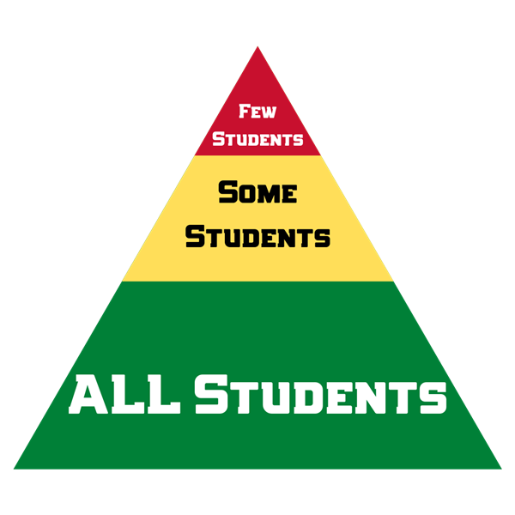
Language of ALL, SOME, FEW
All- Universal supports
Some – Targeted (Essential) supports
Few- Replacement curricula
Notes:
In the next few slides, we will be looking at the different tiers of support within an inclusive model. The new reporting order uses the language of all, some, and few to describe a continuum of support. This support will look different depending on the complexity of the student.

Slide 11
IEPs -All
Notes:
All students are eligible to receive universal assessment supports to support their learning – not just students with disabilities and diverse abilities, or those with an Individual Education Plan (IEP). However, when a student has an IEP, the list of universal supports highlight the learning strategies, supports and assessment practices that are most beneficial for that particular student.
The idea of supports for all comes from Universal Design where it is understood that a design for a special group can benefit multiple users. For example, curb cuts in sidewalks were designed as an accessibility feature for wheelchairs user but are used and benefit parents with stroller, bicyclists, skateboards and pedestrians with other mobility issues.

Slide 12
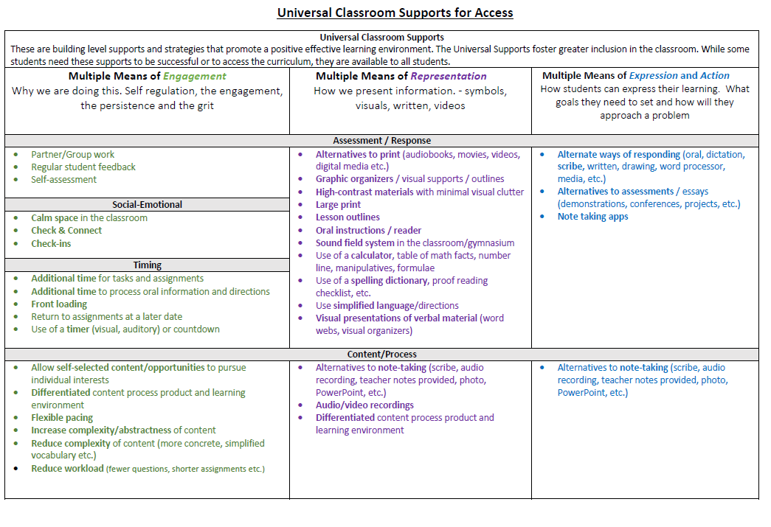
Notes:
Have handout for modules
On this slide are examples of universal supports. These are categorized into multiple means of engagement, representation and expression or action. These universal supports are accessible and beneficial to all students.
It is important to keep in mind that universal assessment supports do not need to be identified on student reports.

Slide 13
PAUSE
What are some of the most common universal supports that student access in your classroom?
Notes:
Please Pause the video at this time and engage in table talk discussions with the following question.
What are some of the most common universal supports that student access in your classroom?

Slide 14
IEPs - Some
Notes:
Some students may require more targeted (essential) assessment supports. It is important to note that targeted (essential ) supports include the use of universal supports as well.
These targeted supports (essential) supports are critical for some students. These are supports identified through hearing, vision, medical or psychoeducational testing in order to reduce barriers to accessing the curriculum.
A student who uses targeted assessment supports:
•Is assessed using the learning standards
•Is reported on in the same manner and timeline as their peers
•Receives full credit for completed courses
•Receives a Dogwood Diploma
It is important to note that a student with an IEP should not be automatically assessed as emerging or developing or at a lower letter grade and percentage because they use supports to access and demonstrate their learning. If, with the supports, the student is demonstrating learning in relation to the learning standards, then they should be assigned a scale indicator or letter grade and percentage according to the learning they have demonstrated. The use of supports does not mean they are not adequately meeting the learning standards.

Slide 15
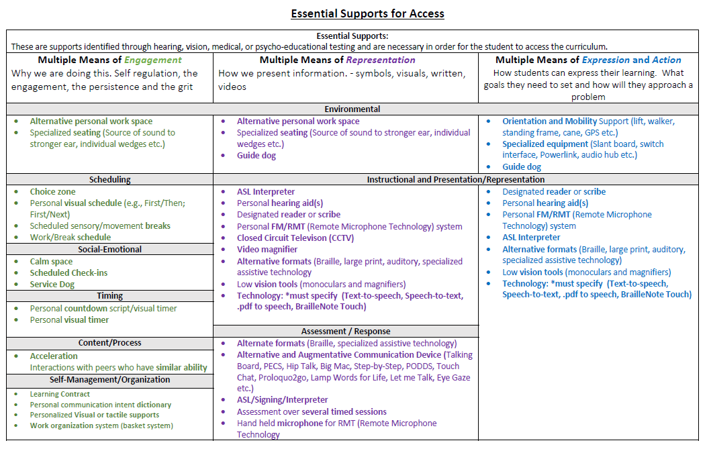
Notes:
On this slide are examples of Targeted (essential) supports. Categorized into multiple means of engagement, representation and expression or action. These targeted (essential) supports are critical for some students. These are supports identified through hearing, vision, medical or psycho-educational testing in order to reduce barrier for accessing the curriculum.
Again, It is important to keep in mind that universal and targeted assessment supports do not need to be identified on student reports.

Slide 16
Example Scenario
Deepak is a grade 8 student with a learning disability. His psycho-educational assessment indicates a significant impairment in processing speed but average academic skills. Deepak's IEP lists extra time on assignments, projects and tests. Since extra time is meant to address a barrier identified in his psychoeducational assessment these are targeted (essential) supports. Deepak receives extra time per his IEP. With these supports Deepak is performing in the proficient range on the proficiency scale.
Notes:
In this scenario although Deepak is utilizing targeted (essential) supports that are documented on his IEP, he should not automatically be assessed as Emerging or Developing or at a lower letter grade and percentage because he uses supports to access and demonstrate learning. The use of supports does not mean he is not adequately meeting the learning standards.

Slide 17
IEPs - Few
Notes:
Few students will require specific assessment supports to support their learning. Typically, this includes students with complex needs who have intellectual disabilities.
However, not all student with intellectual disabilities will require this level of support or they may not require it in every area of learning. For example, a student who requires specific assessment supports in English Language Arts, may need minimal supports in Physical and Health Education.
We have many students with mild intellectual disabilities who do work towards standard curriculum in all areas of learning and graduate with a Dogwood Diploma. Supports for these students will be similar to the previous examples of students with universal and targeted (essential) supports.
However, we also have students with mild to profound intellectual disabilities who may require specific goals and assessment practices to allow for equitable access to areas of learning alongside their peers. This is where the use of IEP replacement curricular goals are utilized.
It is important to presume competence and respond to the individuals needs rather than automatically assuming replacement curriculum is needed. Monitoring students progress at the outset of a new course is key in making the decision to continue working towards standard BC Curriculum or make the switch to related replacement curriculum. When the decision is made to implement replacement curriculum it is done with careful and meaning consultation between the student’s parent and case manager.

Slide 18
Evaluation in Reference to Individualized Learning Goals (Replacement Goals)
Students with disabilities and diverse abilities whose learning is supported by individualized learning goals must have an IEP that outlines their goals and the methods for evaluating the goals. These learning goals are set by teachers in consultation with students, parents, caregivers, and other student support team members (e.g., Specialist Teachers, physiotherapist, speech pathologist, psychologist, educational assistant, occupational therapist) and are recorded in the student’s IEP.
Students receive feedback in a manner that is identified in the individualized learning goals of their IEP (e.g., Proficiency scales, letter grades and percentages, descriptive feedback). Communication of student learning aligns with the school and/or district’s regular reporting periods and formats.
It is also important to note that these students' learning experiences in the classroom should still be connected with the same content and competencies as their peers as their peers are exploring but with modifications (replacement goals) to meet their unique needs.
Notes:
It is important to note that using replacement goals as a method of evaluation and communicating student learning pertains only to the small number of students who are assessed in relation to the individualized learning goals outlined in their IEP, rather than the learning standards. These are students who are working toward an Evergreen (School Completion Certificate) rather than a Dogwood (Certificate of Graduation.)
Students with disabilities and diverse abilities whose learning is supported by individualized learning goals must have an IEP that outlines their goals and the methods for evaluating the goals. These learning goals are set by teachers in consultation with students, parents, caregivers, and other student support team members (e.g., Case Managers, Specialist Teachers, physiotherapists, speech pathologists, psychologists, educational assistants, occupational therapists) and are recorded in the student’s IEP.
Students receive feedback in a manner that is identified in the individualized learning goals of their IEP (e.g., proficiency scales, letter grades and percentages, descriptive feedback). Communication of student learning aligns with the school and/or district’s regular reporting periods and formats.
It is also important to note that these students' learning experiences in the classroom should be aligned with the content and competencies their peers are exploring but with modifications (replacement goals) to meet their unique needs.

Slide 19
Creating Replacement Curricular Goals
Teachers, in collaboration with the student and the student's Case Manager (most often BASES teachers), look at the BC curricular competencies of the grade level and area of learning and pick a few (1-3) specific competencies to focus on.
An individualized objective is created in relation to the curricular competency of focus. This is set as something attainable for the student and specific criteria for evaluating of growth in this competency is clearly defined. This individualized objective is the replacement goal.
The student has access to and engages in all learning activities within the area of learning but is only being evaluated on progress toward the specific replacement curricular goals, not the full BC curriculum for the area of learning.
Notes:
So how are replacement goals created? In the next several slides we will discuss this process, give examples of how this process may look in action and how the communication of this learning can be presented.
Classroom Teachers are responsible for the creation, design and implementation of related learning activities, and evaluation of replacement curricular goals that a student is working towards in their area of learning. The science teacher creates and evaluates the replacement goal(s) for Science, the art teacher for Art Studio.
Of course, this is not done in isolation but in collaboration with the student (if appropriate) and the student’s case manager (typically a B.A.S.E.S. teacher). The classroom teacher is the expert in their area of learning and know the curricular competencies that they want to focus on in their teaching and the Case Manager knows the student’s strengths, needs, and interests. Together, they look at the curricular competencies of the area of learning at grade level and decide on 1 to 3 competencies to focus on for the student.
An individualized objective is created in relation to the curricular competency of focus. This is must be attainable for the student. Specific criteria for evaluating this competency must also be clearly defined. This individualized objective is the replacement goal and recorded in the students IEP by the Case Manager.
This does not mean that this is the only learning that the student engages in during their time in this class. The replacement goals are meant to be an area of focus for the evaluation and reporting of learning in the class. The student has access to and engages in all learning activities within the area of learning but is only being evaluated on progress toward the specific replacement curricular goals, not the learning standards for that class.

Slide 20
Communicating Student Learning in Relation to Replacement Curricular Goals
Reporting should clearly indicate that evaluation and assignment of a proficiency scale indicator or percentage/letter grade is in relation to IEP replacement curricular goals and not BC Curriculum in the area of learning. This is done via report card comments and descriptive feedback.
An individualized reporting form can be utilized to fit replacement curricular goals into standard reporting structures as well as to make this communication more meaningful and authentic. Include strength-based feedback and areas for further growth.
Notes:
In MyEdBC, when students are working towards replacement curricular goals, it should be very clear that the student is not completing all the learning outcomes for the area of learning. Reporting should clearly indicate that evaluation and assignment of a proficiency scale indicator or percentage/letter grade is in relation to IEP replacement curricular goals and not BC Curriculum in the area of learning. This is done via report card comments and descriptive feedback.
An Individualized reporting form can be utilized to fit replacement curricular goals into standard reporting structures as well as to make this communication more meaningful and authentic; including strength-based feedback and areas for further growth.
We will now explore a template and examples of an individualized reporting form.

Slide 21
Notes:
Include this form in the resources
Here is an example of a form that could be utilized to meaningfully interpret and report the learning for a student working towards replacement curricular goals for students in grade 8 and 9. Please take a moment to look at this. This form can be sent home to parents/guardians, as an addendum to the report that is generated in MyEdBC.
Let's now look at an example of this form in use.

Slide 22
Example Scenario 1
Greg is a grade 9 student with Mild Intellectual Disabilities (K-designation)
His psycho-educational assessment describes him as a capable young man with strengths in physical motor skills, sports and verbal comprehension. His challenges include struggles with working memory and critical thinking.
Greg is working towards a replacement curriculum in his "academically heavy" courses including Social Studies and Science, and is currently working on literacy, numeracy and life skills type goals in an IEP related BASES block.
He is working towards the standard BC curriculum in areas of learning such as PE, Art, and Foods.
Greg will be working towards an Evergreen School Leaving Certificate as he moves into his graduation program in years 10-12.
Notes:
Consider the following profile:
Greg is a grade 9 student with Mild intellectual Disabilities (K-designation)
His psychoeducational assessment describes him as a capable young man with strengths in physical motor skills, sports and verbal comprehension with stretches in working memory and critical thinking.
He is working toward replacement curriculum in his "academically heavy" courses like Social Studies and Science and working on literacy, numeracy and lifeskills type goals in an IEP related BASES block.
He is working towards standard curriculum in PE, Art, and Foods.
He will be working towards an Evergreen school leaving certificate as he moves into his graduation program years (10-12).

Slide 23
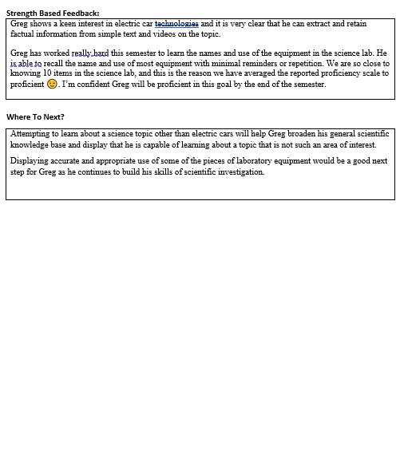
Notes:
Include this example in the resource.
In this science 9 class, it was determined within the first 3-4 weeks of class that Greg would need replacement goals in science 9 to access curriculum at his level and feel success in his learning. The science teacher consulted with Greg’s case manager and they created replacement curricular goals for Greg, they also made sure to communicated this to Greg’s parents and involve them in the conversation.
The following is an example of the mid semester report. This form was sent home to accompany the MyEDBC report generated at this time.
You will see that the competencies are chosen and copied directly from the BC curriculum guide for the area of learning, and the replacement goal related to that competency is created specifically for the individual student. A method for measurement of how this goal relates to the proficiency scale is included with the goals, making it very clear what the evaluated proficiency rating mean in relation to that goal.
The proficiency scale rating that would appear on the MyEdBC report card would reflect the classroom teacher’s evaluation of an overall rating that amalgamates the individual goals as the classroom teacher sees fit.
The strength-based feedback and where to next section provide further opportunity for meaningful and authentic discussion of the students learning in relation to the replacement goals.

Slide 24
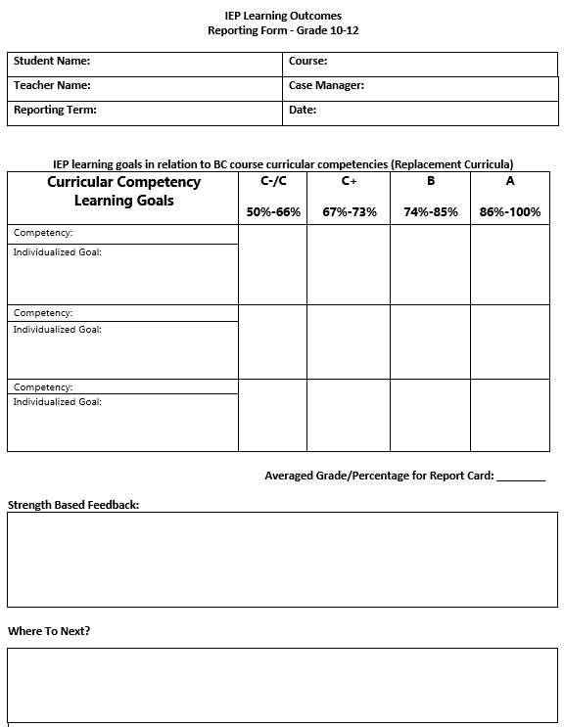
Notes:
Include template in resources
In this second example we explore what this may look like for a students in grades 10-12 with replacement curricular goals. As you can see, this template is very similar to the one for grade 8 and 9, except this time we are evaluating replacement goals with letter grades and percentages.

Slide 25
Example Scenario 2
Kai is a Grade 10 student with Fetal-Alcohol Syndrome (D-designation) and a Moderate to Profound Intellectual Disability (C-designation)
Kai’s ability to plan and execute any task is severely impacted by their diagnosis. They require constant prompting and reminders to complete any tasks. They rely heavily on the use of visual supports and direction from a Teacher or Inclusive Education Support Worker. Kai's fine motor skills are a relative strength, and they enjoy drawing and painting.
Kai is on an Evergreen School Leaving Certificate (Modified) program.
While the majority of Kai’s educational program is very individualized with life skills goals via IEP and BASES programming (ie. personal hygiene, safety in the community, and social/emotional regulation). Kai is also enrolled and included in an Art 10 class which they are able to attend to for approximately 30mins per class.
Notes:
In this example we will look at a student who has a complex learning profile.
Kai is a Grade 10 student with Fetal-Alcohol Syndrome (D-designation) and a Moderate to Profound Intellectual Disabilities (C-designation)
Kai’s ability to plan and execute any task is severely impacted by their diagnosis. they require constant prompting and reminders to complete any tasks. they rely heavily on the use of visual supports and direction from a teacher or Inclusive Education Support Worker. their Fine motor skills are a relative strength and they enjoy drawing and painting.
Kai is on an Evergreen School Leaving certificate (Modified) program.
While the majority of kai’s educational program is very individualized with life skills goals via IEP and BASES programming (ie. personal hygiene, safety in the community, and social/emotional regulation), kai is also enrolled and included in an Art 10 class in which they are able to attend to for approximately 30mins per class.
In this art studio 10 class, the classroom teacher and case manager have worked together to create replacement curriculum at the outset of the course. Having worked with kai for a few years now, their Case Manager has a good understanding of their strengths and needs and knows that replacement curricular goals is the appropriate path for the art course. This, of course, is all done with the case manager ensuring parents are consulted, understand, and agree with the plan.

Slide 26
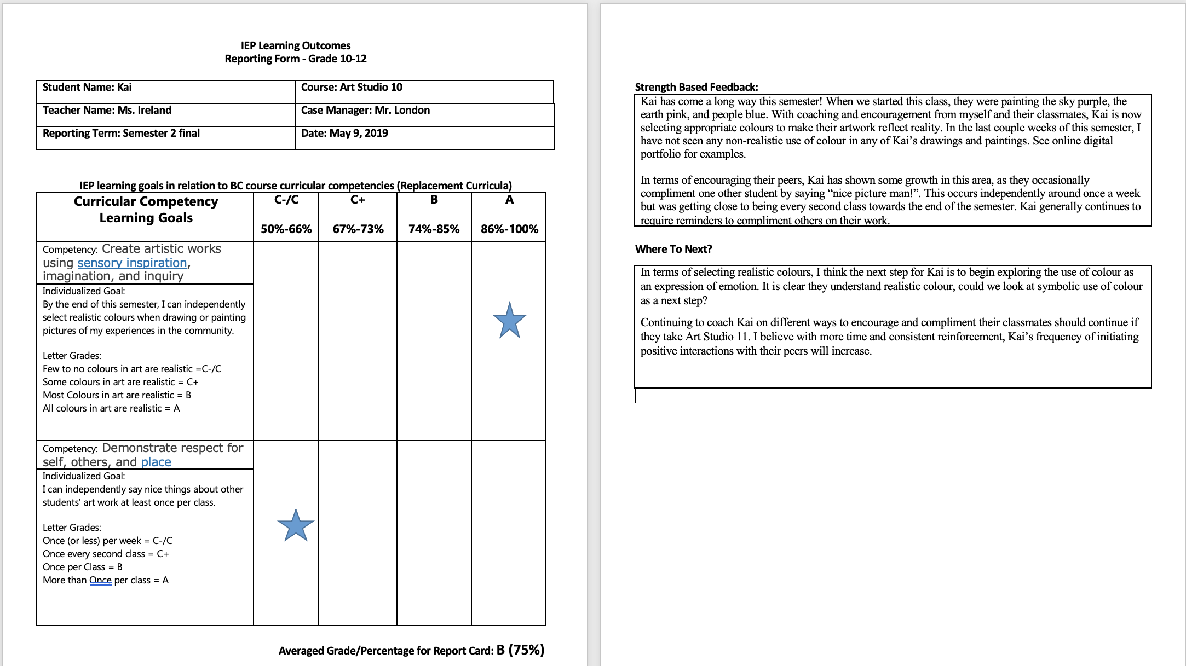
Notes:
Include example in resources:
Please take a moment to look over this example reporting form that would have been sent home with kais report card at the end of the semester. Again, everything here is similar to the grade 8-9 example we looked at, with the exception of letter grade/percentages in place of proficiency scale rating.

Slide 27
PAUSE
What has your experience with IEP replacement (modified) goals been in the past?
How is this similar or different to what the last 2 examples given here?
Notes:
Please Pause the video at this time and engage in table talk discussions with the following question.

Slide 28
In Summary
Most students with IEPs are working towards regular class curriculum and are utilizing universal and targeted (essential) supports to create equitable access to the curriculum and the assessment of their learning. These student are working towards regular Dogwood Diploma graduation
Few students (with diagnosed intellectual disabilities) are working towards replacement curricular goals that are created for them to access curricular areas of learning at their own level. The reporting of these goals utilize proficiency scale language for grade 8 and 9, and letter grade/percentage for grade 10-12, with clearly defined criteria, and clearly indicates class report/evaluation is not on standard BC curriculum in the area of learning. These student are most likely working towards an evergreen school leaving certificate (not regular dogwood diploma)
Consultation and Collaboration with Case Managers is key in developing the right plans for students with IEPs.
Notes:
Read directly from slide

Slide 29
Further Questions/Clarification and Support?
Naginder Sanghera – LST Helping Teacher sanghera_n@surreyschools.ca For student working within the LST framework of your school
Greg England – Special Education Helping Teacher england_g@surreyschools.ca for students working within the B.A.S.E.S. framework of your school

